Slide 1

UE20CS390A – Capstone Project Phase – 1
SEMESTER - VI
END SEMESTER ASSESSMENT
Project Title : Deploying EOX Microservices to Kubernetes Cluster
Project ID : PW_23_VP_01
Project Guide : Prof Venkatesh Prasad, Mr.Vijay R (EOX Vantage)
Project Team : Veena Garag PES1UG20CS492
Adarsh Kumar PES2UG20CS016
Suchit S Kallapur PES1UG20CS438
Yuvaraj D C PES1UG20CS521

Slide 2
Outline
Deploy EOX microservices on Kubernetes Cluster
Problem Statement
Abstract and Scope
Literature Survey
Suggestions from Review – 3
Design Approach
Design Constraints, Assumptions & Dependencies
Proposed Methodology / Approach
Architecture
Design Description
Technologies Used
Project Progress
Plan for Phase 2
References

Slide 3
Problem Statement
Deploy EOX microservices on Kubernetes Cluster
This project deals with deploying EOX microservices on Kubernetes platform. The research and implementation is used to reduce the life-cycle of deployment of the finished containers into cloud In a microservices architecture, each microservice performs a simple task and communicates with clients or other microservices by using lightweight mechanisms such as REST API requests. The microservices can be coded using a programming language that's best suited for the task that it performs. Microservices-based applications are easier to deploy and maintain.

Slide 4
Abstract and Scope
Deploy EOX microservices on Kubernetes Cluster
Our project mainly deals with deploying microservices on cloud.
There are various challenges like security, performance, scalability, cost management, interoperability and flexibility, high dependence on network, and multi cloud environment.
Here we are concerned with performance and scalability while deploying microservices using hybrid cloud platforms.
This is a complex and difficult process when cross-platform comes into play.

Slide 5
Deploy EOX microservices on Kubernetes Cluster
Literature Survey

Slide 6
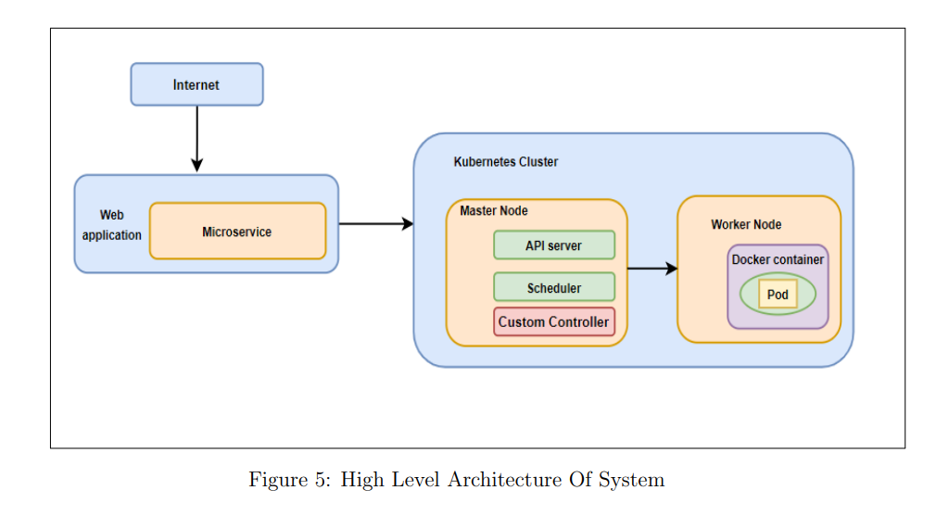
Paper 1
Autoscaling Cloud-Native Applications using Custom Controller of Kubernetes.(2021)
Deploy EOX microservices on Kubernetes Cluster
Introduction:
Kubernetes default algorithm leads to improper resource allocation,
performance degradation, increased maintenance cost. So they
came up with the new algorithm i.e Custom Controller. Default Algorithm is more expensive then Custom Controller. By implementing the Custom Controller the maintenance cost was reduced by almost 50%.
Custom Controller dynamically manages and scales the pods depending on the workload.
Pods will be scheduled based on the number of request coming towards the server. For this research Amazon web services t3.2xlarge instance was used. The microservice-based application is developed in PHP language to perform the computing intensive operations.
To carry out the research in this study, following technologies and tools have been used: Kubernetes, Kubeadm, Kubectl, Docker, PHP-Apache.

Slide 7
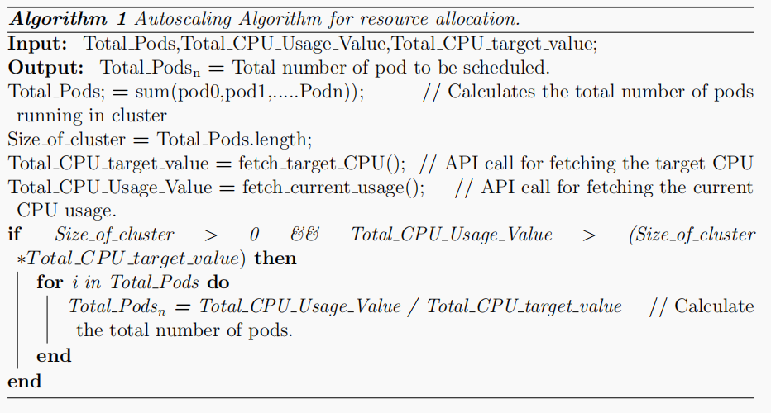
Deploy EOX microservices on Kubernetes Cluster
Autoscaling Cloud-Native Applications using Custom Controller of Kubernetes.
Custom Controller Algorithm

Slide 8
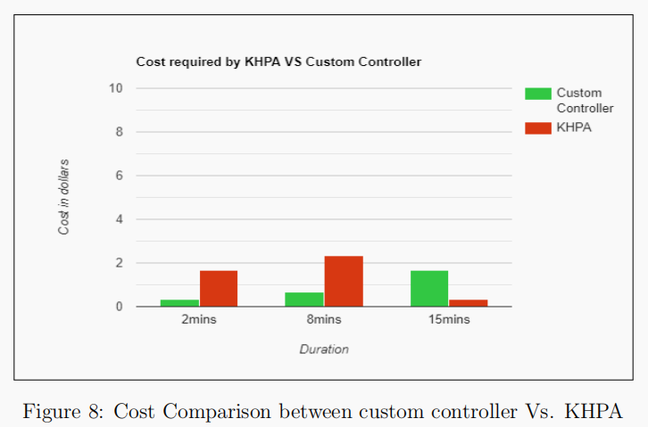
Deploy EOX microservices on Kubernetes Cluster
Autoscaling Cloud-Native Applications using Custom Controller of Kubernetes.
METHODOLOGY: The setup contains one master node and two worker nodes,In this research an attempt is made to write a custom controller to schedule the required number of pods to overcome resource wastage and website crashes. There is a component called Kube-controllermanager.YAML in the Kubernetes cluster. To control replicas, the parameters in the YAML file are transferred to the Kube-API server, and then to the Kube-controller manager. Next, the Kube-API server informs the custom controller to start or create new pods.
EXPERIMENT:
Total 3 experiments were conducted in the timeframe of 2 min, 8
min, 15min. The performance of Custom Controller was compared
with the performance of Kubernetes default algorithm.
The experiments demonstrated that during the first 2 minutes
of workload custom controller allocated 0 pods and KHPA
allocated 3 pods. After 8 minutes of workload generation
Custom controller scheduled 2 pods whereas KHPA schedules
7 pods,extra 4 pods were scheduled by KHPA which is over
provisioning of resources. During the 15 minutes of workload
generation Custom Controller scheduled 5 pods whereas KHPA
scheduled only 1 pod, this leads to performance degradation.

Slide 9
Deploy EOX microservices on Kubernetes Cluster
Autoscaling Cloud-Native Applications using Custom Controller of Kubernetes.
CONCLUSION:
By using a custom controller which makes the autoscaling decisions and schedules the pods, this research attempts to solve the issue of inefficient pod allocation to applications.
FUTURE WORK:
Since replicas take some time to stabilize, this problem can be considered in the future, In addition, the algorithm inside the custom controller can be enhanced for memory and storage intensive microservices so that it will support all type of microservices in the future.

Slide 10
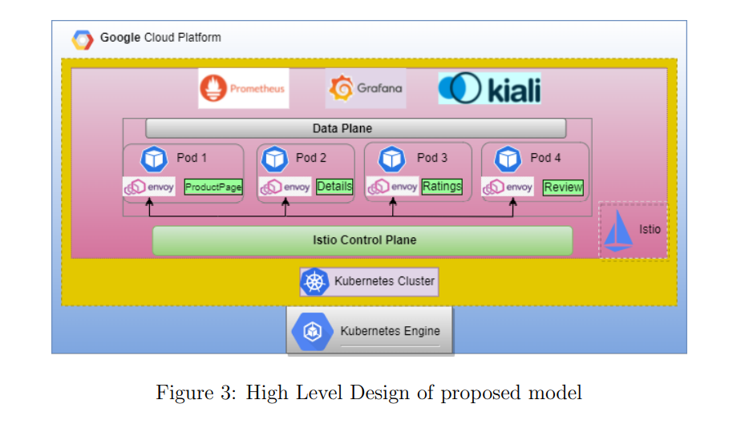
Deploy EOX microservices on Kubernetes Cluster
Paper 2
Dynamic Load Balancing of Microservices in Kubernetes Clusters using Service Mesh (2022)
Introduction:
As the workload on the application continues to increase the default Kubernetes load balancing strategy fails to manage the fluctuating traffic because of its static nature and performs poorly, this paper proposes a technique that uses service-mesh Istio to inject sidecar proxies onto every micro-service and dynamically balances the load among services by applying service-specific routing through the Istio control plane. Inter-service communication is secured by encrypting the traffic among services by means of enforcing mTLS across all services.

Slide 11
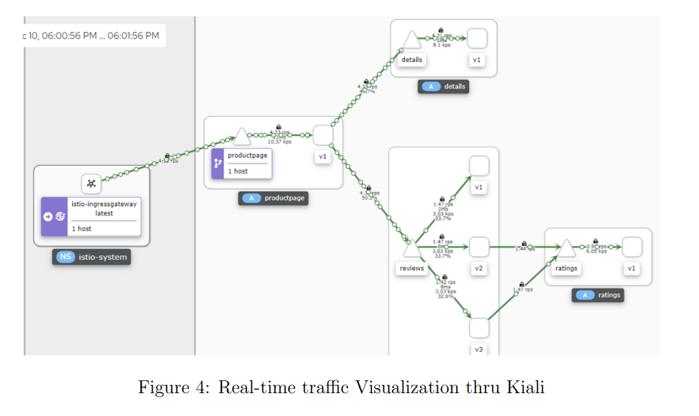
Deploy EOX microservices on Kubernetes Cluster
Dynamic Load Balancing of Microservices in Kubernetes Clusters using Service Mesh
The tools used were: Kubectl, Istio, Istioctl, Kiali, Prometheus Grafana, Locust.
Implementation
The proposed system’s implementation was finished with the order depicted in the above diagram
The Istio-system namespace is created for keeping Istio configurations separate. On this namespace, the network configs (YAML file) are applied on the ingress-gateway. The ingresshost, ingressport, and secureingressport are configured in Istio-ingressgateway. This gateway plays an important role of a load balancer by distributing the incoming load among the various application services. Firewall rules are created in Google Cloud Platform in order to allow the ingress port and secure ingress port which will be used by Istio-ingressgateway

Slide 12
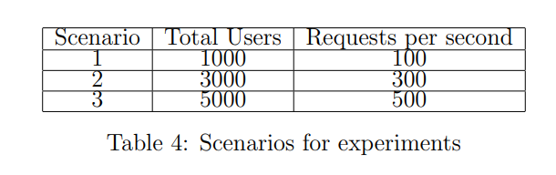
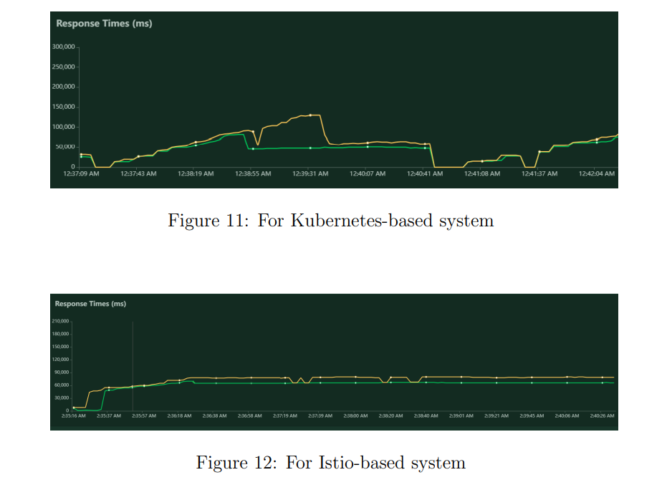
Deploy EOX microservices on Kubernetes Cluster
Dynamic Load Balancing of Microservices in Kubernetes Clusters using Service Mesh
Envoy proxy is injected as sidecar onto every pod that runs a service. All the dynamic routing and security policies that are to be applied among individual services are written in a YAML file named as VirtualService and Enable mTLS respectively. It is then applied onto every sidecar present in every pod through control plane. Locust tool generates load on the bookstore application.
EXPERIMENT:
for each of the test cases shown below, there was 5% improvement in the new proposed model than the default kubernetes based system

Slide 13
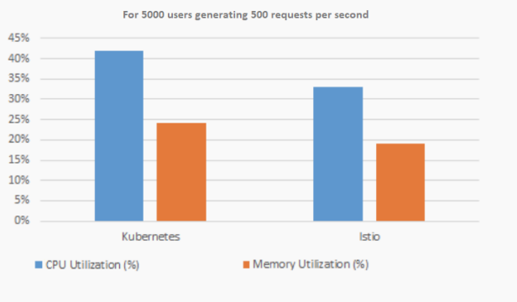
Deploy EOX microservices on Kubernetes Cluster
Dynamic Load Balancing of Microservices in Kubernetes Clusters using Service Mesh
CONCLUSION:
This Research proposes a service-mesh Istio-based system, which efficiently handles the varying requests on a web application using microservices architecture and hosted on a Kubernetes cluster by, improving the response time and consuming fewer resources as compared to traditional kubernetes system.
FUTURE WORK:
Further research to reduce the latency and complexity can be done

Slide 14
Deploy EOX microservices on Kubernetes Cluster
Paper 3
An Efficient and Scalable Traffic Load Balancing Based on Webserver Container Resource Utilization using Kubernetes Cluster (2022)
Introduction:
Managing the containers is always a task for any company because microservices that are running on the containers do not communicate with each other. They work independently as a separate entity. This is where Kubernetes steps in. Kubernetes is nothing but a platform to manage containers.
Install and set up the Kubernetes cluster on all these three-node with one master and 2 worker/slave kinds of architecture where you get the benefit of container failover advanced in case any VM is failed/rebooted.
They use the Round Robin algorithm to equally balance the load among all application containers.

Slide 15
Deploy EOX microservices on Kubernetes Cluster
An Efficient and Scalable Traffic Load Balancing Based on Web Server Container Resource Utilization using Kubernetes Cluster
The proposed system is comprised of the following modules:
Module 1: Setup phase
Module 2: Build Kubernetes Cloud and Containers:
Module 3: Deploy Application
Module 4: Deploy backend scripts: Deploy the proposed algorithm in the form of script, which monitor real-time traffic patterns, and as per container traffic handling limit/threshold set it will dynamically scale up, scale down the web servers container, and add the same behind load balance too to balance the traffic.
Module 5: Dynamic scaling and High availability
Module 6: Analysis Reports

Slide 16
Deploy EOX microservices on Kubernetes Cluster
An Efficient and Scalable Traffic Load Balancing Based on Web Server Container Resource Utilization using Kubernetes Cluster
METHODOLOGY: PROPOSED ALGORITHM
Horizontal Container Scaling Algorithm:
Desired App Replicas = ceil [current App Replicas* (current Scaling Metric Value / desired Scaling Metric Value)]
EXPERIMENT:
Let us say we have a scaling configuration with a target CPU usage of 70%, a minimum pod count of 4, and a
maximum pod count of 20. The current deployment status is six pods averaging
95% usage. Desired Replicas = ceil [6*(85/70)] = ceil (8.14) = 9
Scaling down Algorithm:
Let us say we have a pod-scaling configuration with a target CPU usage of 70%, a minimum pod count of 4, and a maximum pod count of 20.The current application pod deployment status is: There are 10 total pods. 10 pods averaging 45% usages.The same algorithm we used to scale down the application pod:
The formula is applied to all normal pods.
Desired Replicas = ceil [10*(45/70)] = ceil (6.42) = 7

Slide 17
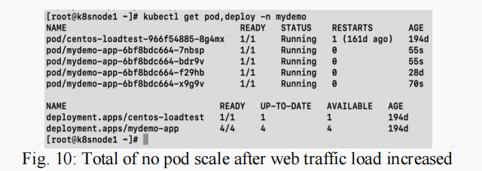
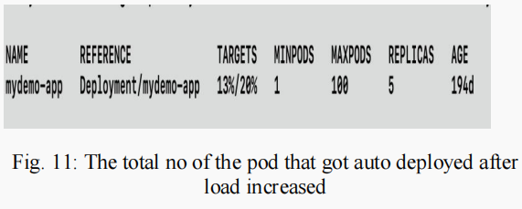
Deploy EOX microservices on Kubernetes Cluster
An Efficient and Scalable Traffic Load Balancing Based on Web Server Container Resource Utilization using Kubernetes Cluster

Slide 18
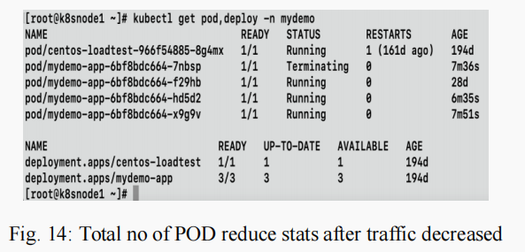
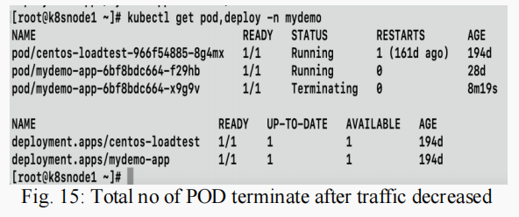
Deploy EOX microservices on Kubernetes Cluster
An Efficient and Scalable Traffic Load Balancing Based on Webserver Container Resource Utilization using Kubernetes Cluster
CONCLUSION:
The paper proposed a dynamic scaling algorithm considering backend latency for large traffic platforms and applications which will be dynamically scaled up and down as per user request and traffic demand.

Slide 19
Deploy EOX microservices on Kubernetes Cluster
Paper 4
Managing Multi-Cloud Deployments on Kubernetes with Istio, Prometheus and Grafana (2022)
INTRODUCTION:
To remove single-vendor dependency, Cloud-Architects use a multi-cloud environment. Multi-cloud refers to the use of many cloud providers and services in a single cloud network infrastructure. Multi-cloud environments are used to gain all benefits from different vendors like distribute computing resources, minimum downtime and high data availability.
This multi-cloud will be a mixed environment that will take advantage of many infrastructure environments, such as private and public clouds

Slide 20
Deploy EOX microservices on Kubernetes Cluster
Managing Multi-Cloud Deployments on Kubernetes with Istio, Prometheus and Grafana
Pros and Cons of single vendor cloud :
PROS :
Easy negotiation by having a single entity to negotiate with.
No finger-pointing between the several vendors as single vendor is solely responsible for any issue.
Easy procedure for support and services.
Easy integration of the services.
Less training required for users.
Chances of compatibility issues will be less.
CONS :
Less power in price negotiations.
Dependence on the single vendor procedure in each case.
Less freedom of choice for services.
Vendor lock-in problems are more probable.
Training is required for every new service, which also sometimes a paid service.
Not supportive for the technologies like operating systems, switches or protocols.
Might be the issue of the vendor lock-in like backup, disaster and recovery.

Slide 21
Deploy EOX microservices on Kubernetes Cluster
Managing Multi-Cloud Deployments on Kubernetes with Istio, Prometheus and Grafana
Multi-Vendors Cloud :
Anthos:- Anthos Service Mesh is Google's implementation of the powerful Istio open-source project, allowing you to manage, observe, and secure your services without having to change your application code
Multi-public cloud infrastructure has great advantages like negotiating power, risk mitigation, low latency etc and also use the unique features of various vendors platforms allow for innovation and specific requirement of the company. Various technologies like Kubernetes, Istio, Grafana and Prometheus are used to bring this idea to reality
VPN connection is used to connect two clusters running on Cloud vendors infrastructure.
Kubernetes plays a major role here of managing workloads across different cloud platforms and automates various manual process like horizontal scaling, rollouts and rollbacks

Slide 22
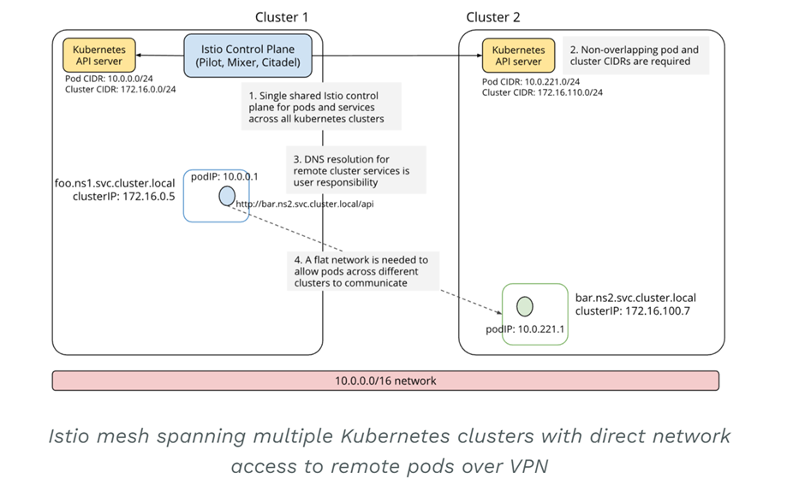
Deploy EOX microservices on Kubernetes Cluster
Istio will provide a number of key capabilities across a network of services. It provides traffic management, observability and security to the services mesh.
In this architecture, two or more kubernetes clusters running a remote configuration are connected to the Istio control plane, later in which Envoy can then form a mesh network across multiple clusters
Grafana, an open source metric analytics & visualization suite. It allows you to visualize, query, alert-on metrics data. Also, create, share, and explore dashboards with your team. Prometheus, a system monitoring and alerting open source toolkit

Slide 23
Deploy EOX microservices on Kubernetes Cluster
Summary of Literature Survey
After analysing all these papers, we get some insights on how to deploy and manage microservices in multiple public cloud platforms, by making use of various tools like istio, grafana, prometheus etc.
We came across various algorithms that talk about efficient load balancing techniques - horizontal container scaling algorithm, scaling up and down algorithms, and dynamic scaling algorithms.
We could also see that the default kubernetes algorithm can lead to inefficient usage of resources when the number of requests are high, hence the paper propose a custom controlled algorithm which actually gave 50% cost reduction.

Slide 24
Deploy EOX microservices on Kubernetes Cluster
Design Constraints :
Resource limitations of the Kubernetes cluster, such as available CPU, memory, and storage. Some of the features by Kubernetes that help to this are resource quotas, resource limits, and resource requests.
Network connectivity between microservices and with external services, including load balancers and ingress controllers. Service objects, provide a stable IP address and DNS name & Ingress objects, which expose HTTP and HTTPS routes from outside the cluster.
Security considerations, such as access control (RBAC), authentication, and encryption.
Monitoring and logging requirements to ensure service availability and troubleshoot issues. Used during testing phase.
Platform compatibility: Kubernetes may have compatibility constraints with certain operating systems, programming languages (may not have libraries), or other technologies that can limit the choice of tools and technologies used for deploying microservices.
Veena, Adarsh, Suchit, Yuvaraj

Slide 25
Deploy EOX microservices on Kubernetes Cluster
Assumptions:
The microservices are designed to be stateless and scalable, with multiple replicas running in parallel to handle traffic.
Containerization: Microservices deployed on Kubernetes are typically containerized, so it is assumed that each microservice can be packaged as a container image that can be deployed on the platform.
Service Discovery: Service discovery is an important assumption when deploying microservices on Kubernetes. It is assumed that each microservice can be discovered by other services in the cluster, allowing them to communicate with each other.
The microservices are independent and loosely coupled, with minimal dependencies on other microservices or infrastructure components.
Veena, Adarsh, Suchit, Yuvaraj

Slide 26
Deploy EOX microservices on Kubernetes Cluster
Dependencies
Kubernetes resources such as pods, deployments, services, and ingress controllers, are used to manage the lifecycle and networking of microservices.
Container images are stored in a container registry, such as Docker Hub or Google Container Registry and pulled by Kubernetes nodes when needed.
Service discovery and load balancing are provided by Kubernetes services, which can route traffic to the appropriate microservice instance.
Persistent storage for microservices, such as databases or file systems, are provisioned using Kubernetes Persistent Volumes and Claims. Thus it is important to ensure that storage is properly configured and accessible by the microservices.
A well configured network to enable communication between microservice.
Veena, Adarsh, Suchit, Yuvaraj

Slide 27
Deploy EOX microservices using cloud platform service and improving scalability
Proposed Methodology / Approach
Methodology for microservice deployment on Kubernetes
To address the challenges of microservice deployment on Kubernetes, we propose a methodology that includes the following steps: design, build, test, deploy, and monitor.
During the design phase, the microservices are identified and their dependencies are mapped out. In the build phase, the services are developed and containerized. Testing ensures that each service works correctly and communicates with other services. Deployment involves setting up the Kubernetes cluster and deploying the services. Finally, monitoring ensures that the services are running correctly and alerts are raised if any issues arise.
Veena, Adarsh, Suchit, Yuvaraj

Slide 28
Deploy EOX microservices on Kubernetes Cluster
Proposed Methodology / Approach
The methodology for load balancing and scalability
Custom Controller Algorithm
Deshpande, Neha (2021) Autoscaling Cloud-Native Applications using Custom Controller of Kubernetes.
https://norma.ncirl.ie/5089/
Masters thesis, Dublin, National College of Ireland.
Veena, Adarsh, Suchit, Yuvaraj

Slide 29
Deploy EOX microservices on Kubernetes Cluster
Proposed Methodology / Approach
METHODOLOGY:
The setup contains one master node and two worker nodes,In this research an attempt is made to write a custom controller to schedule the required number of pods to overcome resource wastage and website crashes. There is a component called Kube-controllermanager.YAML in the Kubernetes cluster. To control replicas, the parameters in the YAML file are transferred to the Kube-API server, and then to the Kube-controller manager. Next, the Kube-API server informs the custom controller to start or create new pods.
CONCLUSION:
By using a custom controller which makes the autoscaling decisions and schedules the pods, this research attempts to solve the issue of inefficient pod allocation to applications.
Veena, Adarsh, Suchit, Yuvaraj

Slide 30
Deploy EOX microservices on Kubernetes Cluster
Proposed Methodology / Approach
Benefits and Drawbacks of the proposed methodology
Reduce cost for maintaining Quality of Service(QoS)
Supports only CPU intensive microservices
Veena, Adarsh, Suchit, Yuvaraj

Slide 31
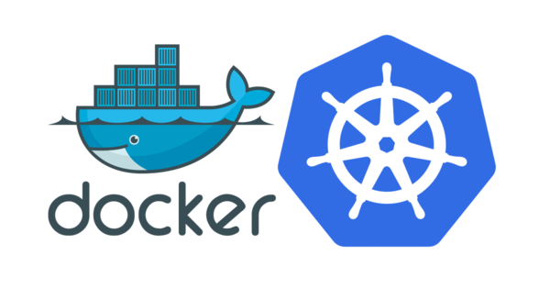
Deployment architecture of microservices in kubernetes cluster
Deploy EOX microservices on Kubernetes Cluster
Veena, Adarsh, Suchit, Yuvaraj

Slide 32
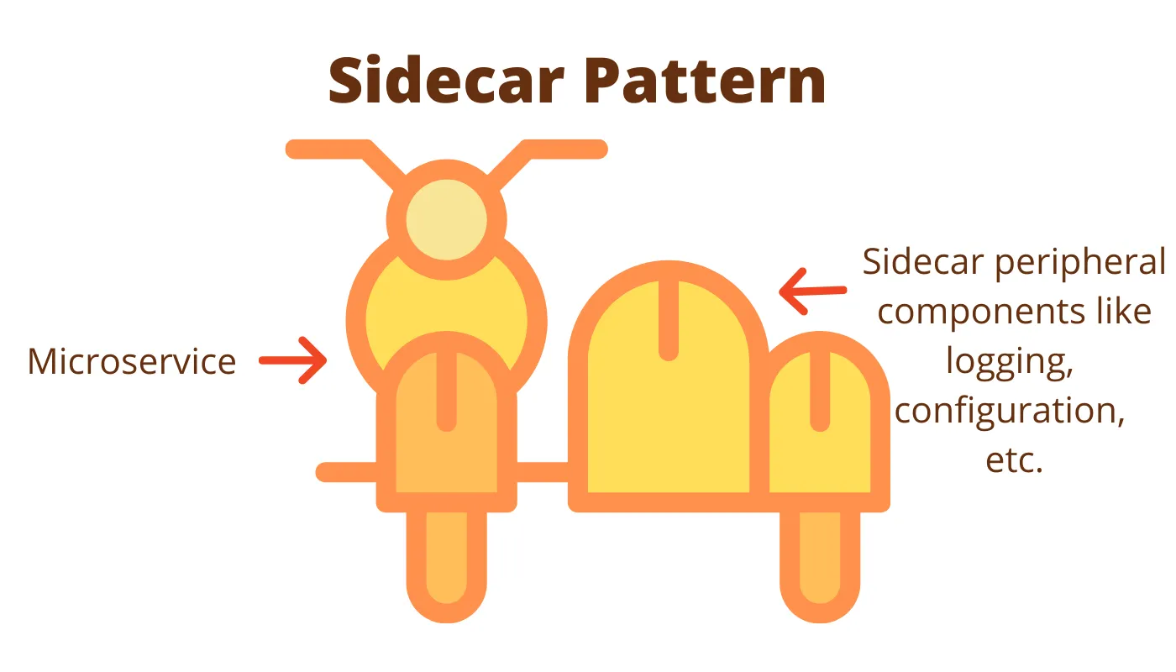
What are the design patterns used to deploy these microservices to kubernetes cluster
Deploy EOX microservices on Kubernetes Cluster
There are various design patterns that can be used but depending on the application the pattern can used
One such design pattern is the sidecar design pattern
Veena, Adarsh, Suchit, Yuvaraj

Slide 33
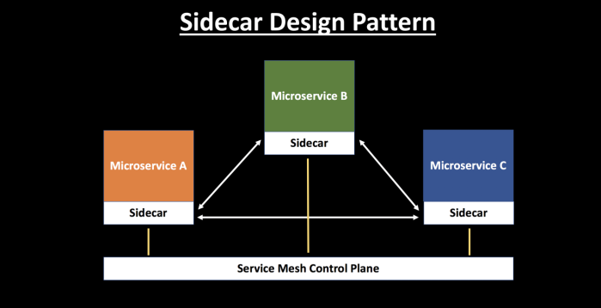
Sidecar design pattern
Deploy EOX microservices on Kubernetes Cluster
Each microservice is associated with a sidecar, which is used to manage traffic flow between the microservices gathers telemetry data, and enforces policies.
The sidecars abstract away complexity from the application and handle functionalities like service discovery, traffic management, load balancing, circuit breaking, etc.
Veena, Adarsh, Suchit, Yuvaraj

Slide 34
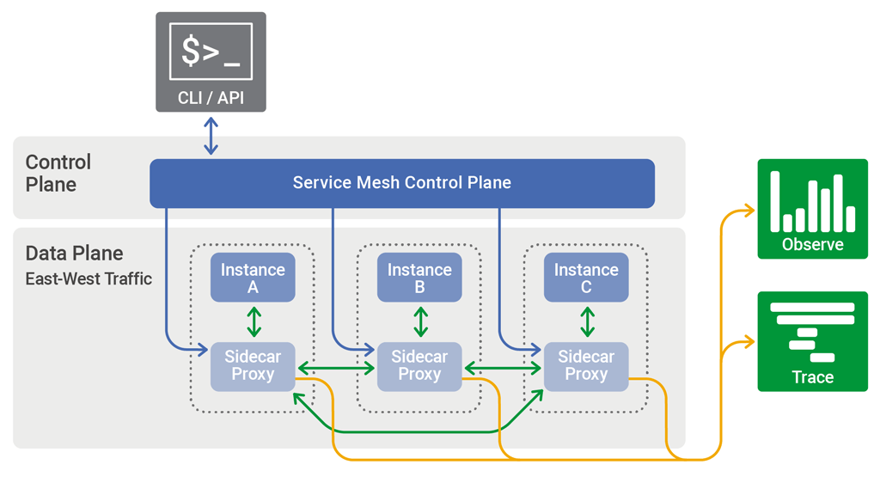
Deploy EOX microservices on Kubernetes Cluster
Service-mesh Architecture
Veena, Adarsh, Suchit, Yuvaraj

Slide 35
Deploy EOX microservices on Kubernetes Cluster
Key features:
1. Data plane: The data plane is responsible for managing the traffic between the microservices. It is typically composed of a set of lightweight proxy instances, such as Envoy, that are deployed alongside each microservice instance. These proxies handle all of the network traffic between microservices and provide features such as load balancing, routing, and service discovery.
2. Control plane: The control plane is responsible for managing the data plane proxies and providing high-level policies and configuration for the microservices deployment. It typically includes a set of control plane components, such as Istio or Linkerd, that work together to configure and manage the proxies.
Veena, Adarsh, Suchit, Yuvaraj

Slide 36
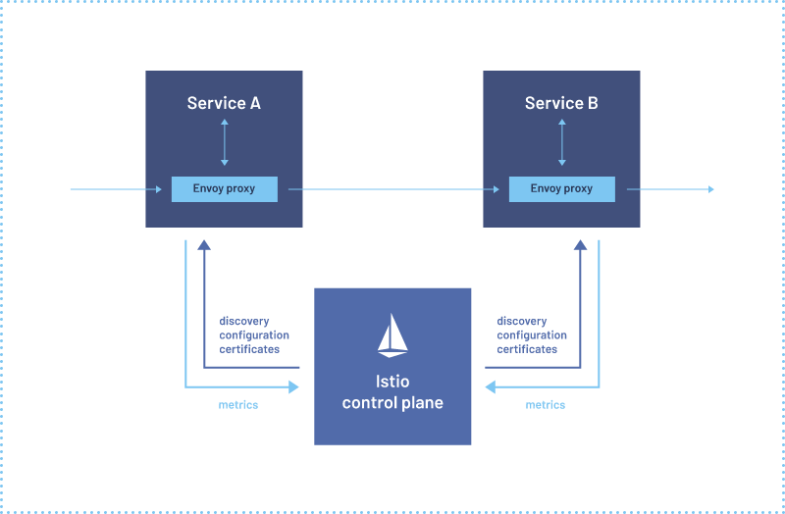
Istio service mesh architecture
Deploy EOX microservices on Kubernetes Cluster
Veena, Adarsh, Suchit, Yuvaraj

Slide 37
Deploy EOX microservices on Kubernetes Cluster
Istio is an open-source service mesh platform
It helps manage and secure microservices in a Kubernetes cluster
1. Envoy proxy: Istio deploys a sidecar proxy, the Envoy proxy, alongside each service instance in the cluster. The proxy intercepts all inbound and outbound traffic to the service instance and sends it through the Istio data plane.
2. Istio data plane: The Istio data plane consists of a set of Envoy proxies and a control plane. The Envoy proxies forward requests to other services and implement the various Istio features such as traffic management, security, and observability.
3. Istio control plane: The Istio control plane manages the Envoy proxies and their configuration. It provides a central place to configure and manage the various Istio features, such as routing rules, security policies, and telemetry.
Veena, Adarsh, Suchit, Yuvaraj

Slide 38
Deploy EOX microservices on Kubernetes Cluster
4. Traffic management: Istio can route traffic between services based on various criteria, such as HTTP headers, source IP address, or user identity. It can also implement features like load balancing, circuit breaking, and retries.
5. Security: Istio can enforce mutual TLS authentication between services, implement access control policies, and provide encryption for service-to-service communication.
6. Observability: Istio provides various telemetry features such as request tracing, metrics, and logging. This allows operators to understand how traffic is flowing through the system and to diagnose issues
Veena, Adarsh, Suchit, Yuvaraj

Slide 39
Using service-mesh architecture on top of kubernetes
Deploy EOX microservices on Kubernetes Cluster
This will result in addon benefits from both the aspects,
Inherent properties of kubernetes like autoscaling, self healing, service discovery and load balancing etc and communication advantages from service mesh architecture
We are basically thinking to implement service mesh architecture of deployment on kubernetes this will allows better communication and scalability and performance.
We can also have an abstraction layer to implement custom control algorithm for autoscaling of pods because in literature we saw that default kubernetes algorithm play bad when lot of requests are directed autoscaling will simply deploy too many nodes and result in wastage of resources.
Veena, Adarsh, Suchit, Yuvaraj

Slide 40
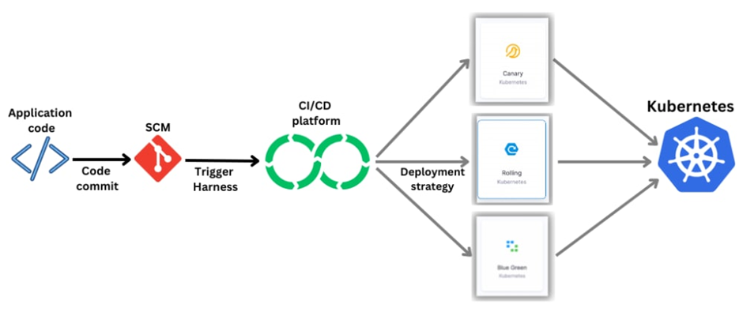
How do we deploy it
Deploy EOX microservices on Kubernetes Cluster
There are various strategies of deployment rolling, bluegreen, canary deployment
Veena, Adarsh, Suchit, Yuvaraj

Slide 41
Deploy EOX microservices on Kubernetes Cluster
Canary deployment
Kubernetes canary deployment is a technique for rolling out new features or changes to a small subset of users or servers before releasing the update to the entire system. This is done by creating a new replica set with the updated version of the software while keeping the original replica set running. A small percentage of traffic is then routed to the new replica set, while the majority of the traffic continues to be served by the original replica set.
Rolling deployment
Rolling deployment involves creating a new replica set with the updated version of the software while gradually scaling down the old replica set.
Blue-green deployment
The Blue-Green Kubernetes deployment strategy is a technique for releasing new versions of an application to minimise downtime and risk. It involves running two identical environments, one serving as the active production environment (blue) and the other as a new release candidate (green). The new release candidate is thoroughly tested before being switched with the production environment, allowing for a smooth transition without any downtime or errors.
Veena, Adarsh, Suchit, Yuvaraj

Slide 42
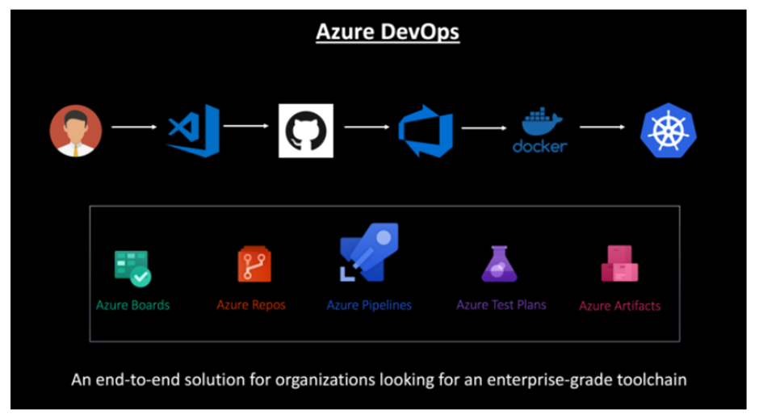
CI/CD Pipeline to Deploy Microservices on Kubernetes
Deploy EOX microservices on Kubernetes Cluster
In a microservice ecosystem, containers make it easy for you to build and deploy services. You can orchestrate the deployments of these containers using Kubernetes in Azure Container Service
In the below CI/CD Pipeline leveraging Azure DevOps, a developer modifies the code and checks it into GitHub.
Veena, Adarsh, Suchit, Yuvaraj

Slide 43
Deploy EOX microservices on Kubernetes Cluster
Using Azure DevOps, continuous integration triggers the application build, the container image is built and the unit tests are executed.
The container image is pushed to Azure Container Registry.
Continuous deployment triggers the application deployment into Managed Kubernetes — Azure Container Service
Veena, Adarsh, Suchit, Yuvaraj

Slide 44
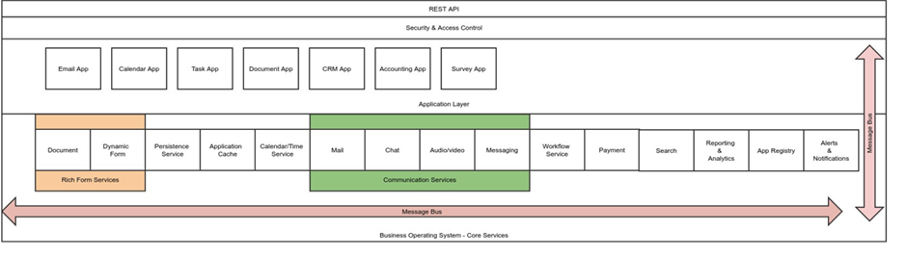
EOX vantage logical architecture of application and services
Deploy EOX microservices on Kubernetes Cluster
Veena, Adarsh, Suchit, Yuvaraj

Slide 45
Deploy EOX microservices on Kubernetes Cluster
Technologies Used
Docker: Docker is a software platform that enables developers to use containers for their applications. Containers are self-contained environments with all the necessary dependencies and configurations for an application to run. Docker provides tools and services such as Docker Engine, Docker Hub, Docker Compose and Docker Swarm to help developers create, share and manage containers across various platforms and environments.
Kubernetes: Kubernetes is a software that orchestrates containers, such as Docker, on a cluster of servers. Kubernetes allows you to deploy, scale and manage our containerized applications in a portable and extensible way. Kubernetes can also handle the health and availability of our applications, as well as the network and storage resources they need.
Minikube: Minikube is a tool that lets you run Kubernetes locally on your personal computer. It creates a single-node or a multi-node cluster that you can use to test and develop applications for Kubernetes. Minikube uses Docker as the default container runtime, but you can change it to other runtimes such as containerd. With minikube, you can easily access Kubernetes features such as Services, Ingress, and Dashboard.
Veena, Adarsh, Suchit, Yuvaraj

Slide 46
Deploy EOX microservices on Kubernetes Cluster
Project Progress
Install of Docker and setup
Install MySql 5.7
Database Creation and configuration of rules.
Build API using docker-compose
Database Migration (ongoing currently)
Veena, Adarsh, Suchit, Yuvaraj

Slide 47
Summary of work done in Capstone Phase-1
Deploy EOX microservices on Kubernetes Cluster
Understanding the problem statement, challenges, and outcome.
Literature survey on the problem statement and figuring out the architecture and design approach to the problem.
Understanding how these approaches will help in solving the problem of scalability and performance.
Rough idea on the architecture and solution along with plans for implementation in phase 2
Veena, Adarsh, Suchit, Yuvaraj

Slide 48
Project Plan for Capstone Phase-2
Deploy EOX microservices on Kubernetes Cluster
Phase 2 will involve the implementation of the proposed architecture and design to the problem.
Deployment of finished containers on the kubernetes cluster using the proposed solution
Testing using tools like kiali, prometheus, grafana or features provided by the istio.
We might have to use an e-commerce application for the demonstration purpose
Veena, Adarsh, Suchit, Yuvaraj

Slide 49
Deploy EOX microservices on Kubernetes Cluster
References
Deshpande, Neha (2021) Autoscaling Cloud-Native Applications using Custom Controller of Kubernetes.
https://norma.ncirl.ie/5089/
Masters thesis, Dublin, National College of Ireland.
Shitole, Abishek Sanjay (2022) Dynamic Load Balancing of Microservices in Kubernetes Clusters using Service Mesh.
https://norma.ncirl.ie/5943/
Masters thesis, Dublin, National College of Ireland.
An Efficient and Scalable Traffic Load Balancing Based on Web Server Container Resource Utilization using Kubernetes Cluster.(May – 2022) Ashok L Pomnar,
AVCOE Sangamner 422 605,Maharashtra, India.
https://ijisrt.com/assets/upload/files/IJISRT22MAY1644_(1)_(1).pdf
V. Sharma, "Managing Multi-Cloud Deployments on Kubernetes with Istio, Prometheus and Grafana," 2022 8th International Conference on Advanced Computing and Communication Systems (ICACCS), Coimbatore, India,
https://doi.org/10.1109/ICACCS54159.2022.9785124
Veena, Adarsh, Suchit, Yuvaraj

Slide 50
Deploy EOX microservices using cloud platform service and improving scalability
Thank You
Veena, Adarsh, Suchit, Yuvaraj

